Slide 1
LINK ANALYSIS
NHẬP MÔN BIG DATA

Slide 2
Content
Graph and Large graph
Web graph
Link analysis
  3.1. Introduce
  3.2. Page rank algorithm
  3.3. Page rank for massive data
  3.4. Hits algorithm
  3.5. Trust rank
  3.6. Web spam
Conlusion

Slide 3
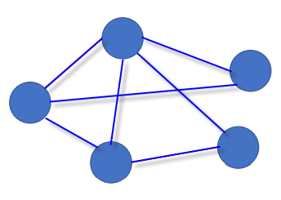
Graph and Large graph
What is a Graph?
a set of vertices (nodes) connected by a set of edges (links)

Slide 4
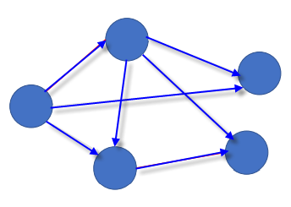
Graph and Large graph
What is a Graph?
edges may be directed → directed graph

Slide 5
Graph and Large graph
What is a Graph?
edges may be undirected →undirected graph

Slide 6
Graph and Large graph
A graph is a model used to represent many types of data, e.g.:
Internet (i.e., the set of interconnected computers)

Slide 7
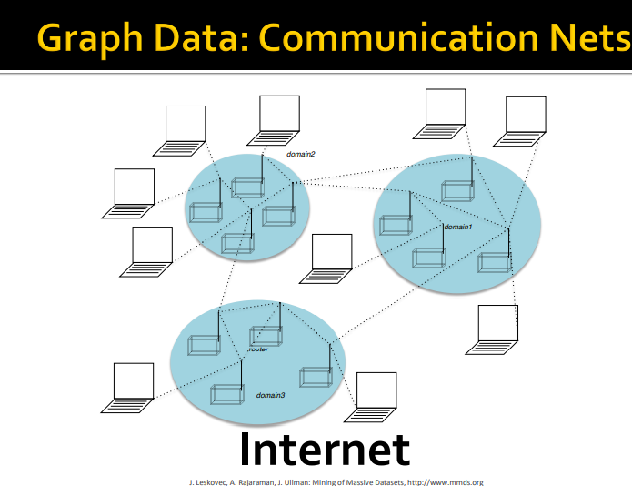
Graph and Large graph

Slide 8
Graph and Large graph
A graph is a model used to represent many types of data, e.g.:
Internet (i.e., the set of interconnected computers)
Maps (i.e., the set of cities and roads connecting them)

Slide 9
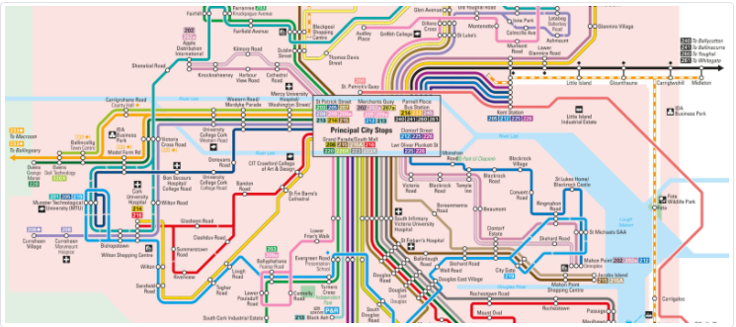
Graph and Large graph
Graph Data: CORK CITY BUS SERVICES

Slide 10
Graph and Large graph
A graph is a model used to represent many types of data, e.g.:
Internet (i.e., the set of interconnected computers)
Maps (i.e., the set of cities and roads connecting them)
Social Networks (i.e., the set of social connections between people)

Slide 11
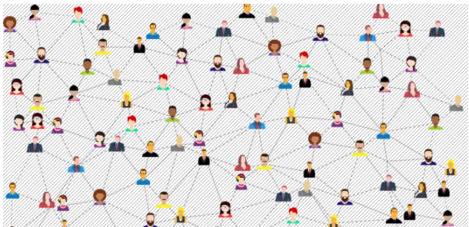
Graph and Large graph
Graph Data: SOCIAL NETWORK LIKE FACEBOOK
https://www.euroscientist.com/imagine-a-social-network-like-facebook-with-no-facebook/

Slide 12
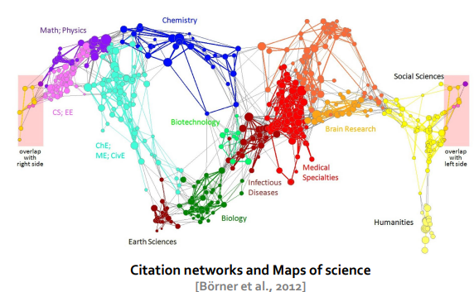
Graph and Large graph
Graph Data: Information Nets

Slide 13
Graph and Large graph
A graph is a model used to represent many types of data, e.g.:
Internet (i.e., the set of interconnected computers)
Maps (i.e., the set of cities and roads connecting them)
Social Networks (i.e., the set of social connections between people)
Web (i.e., the set of hyperlinked web pages)
…

Slide 14
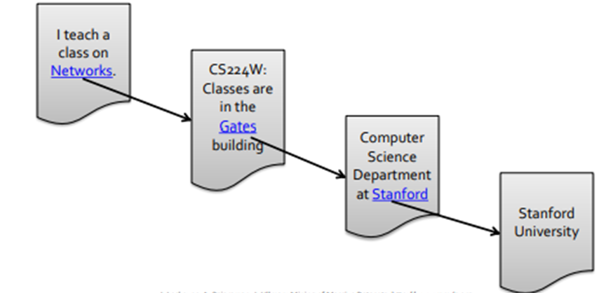
Graph and Large graph
Web as a directed graph
Nodes: Webpages. Edges: Hyperlinks

Slide 15
Graph and Large graph
A graph is a model used to represent many types of data,
e.g.:
Internet (i.e., the set of interconnected computers)
Maps (i.e., the set of cities and roads connecting them)
Social Networks (i.e., the set of social connections between people)
Web (i.e., the set of hyperlinked web pages)
…
• Several "Big Data" tasks require us to work with large graphs

Slide 16
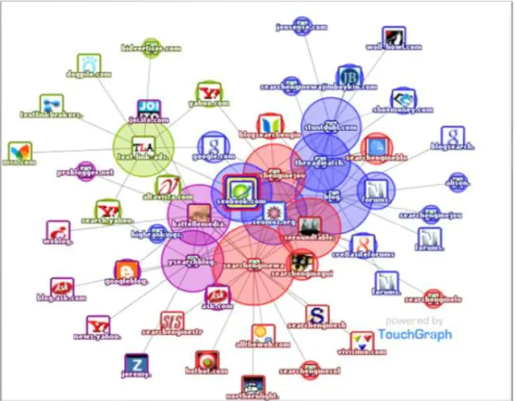
Web graph

Slide 17
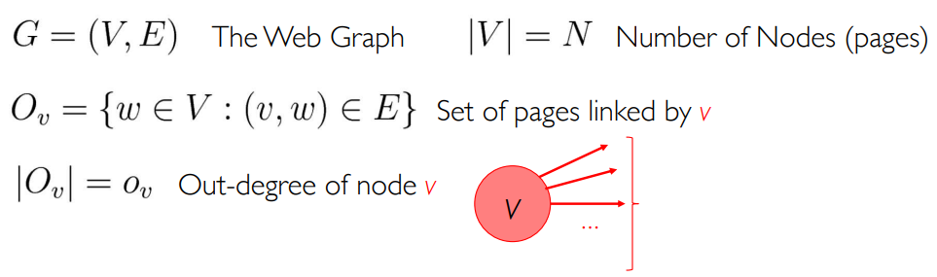
Web graph

Slide 18

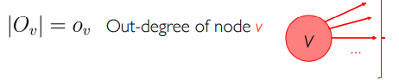
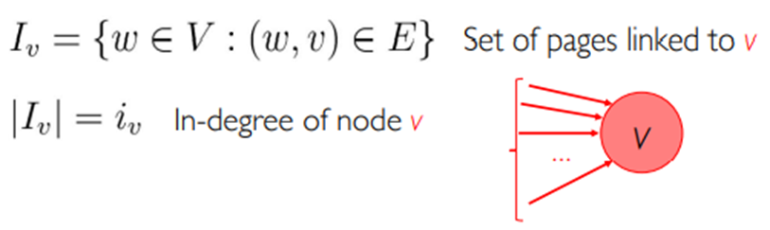
Web graph

Slide 19
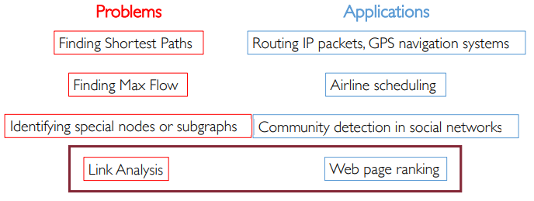
Web graph
Some Famous Graph Problems

Slide 20
Content
Graph and Large graph
Web graph
Link analysis
  3.1. Introduce
  3.2. Page rank algorithm
  3.3. Page rank for massive data
  3.4. Hits algorithm
  3.5. Trust rank
  3.6. Web spam
Conlusion

Slide 21
Introduce
Link Analysis
A data analysis technique used to evaluate relationships (connections) between nodes of a graph

Slide 22
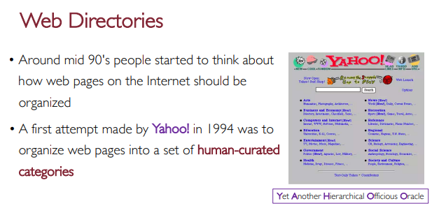
Introduce

Slide 23
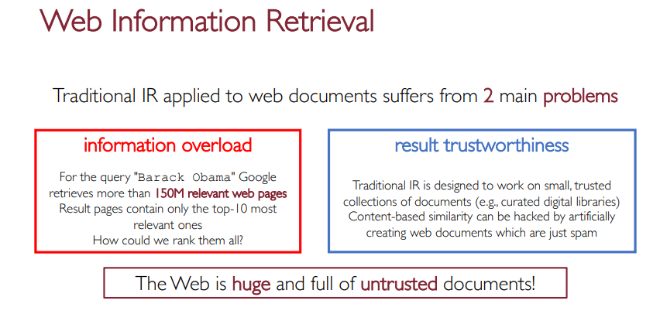
Introduce
[1] Big Data Computing, Gabriele Tolomei, Department of Computer Science Sapienza Università di Roma, 2020-2021

Slide 24
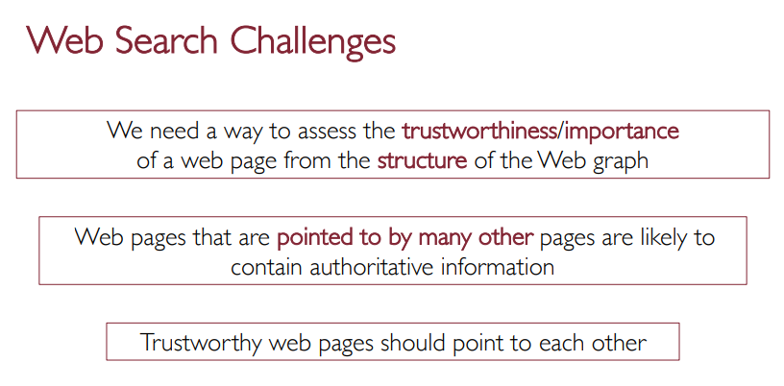
Introduce

Slide 25
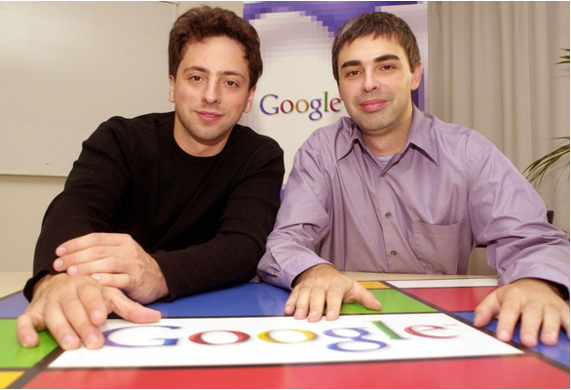
  Pagerank
Larry Page và Sergey Brin - 7/1998

Slide 26
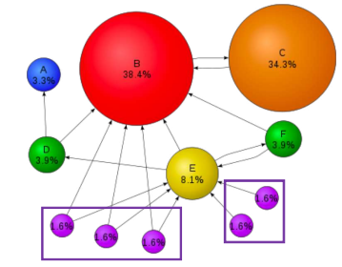
Pagerank

Slide 27
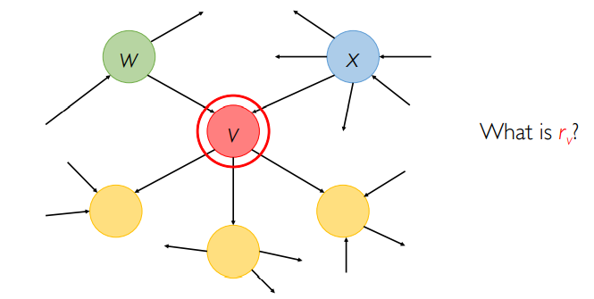
Pagerank
[1] Big Data Computing, Gabriele Tolomei, Department of Computer Science Sapienza Università di Roma, 2020-2021

Slide 28
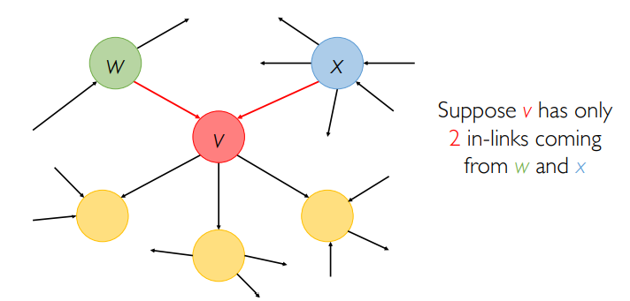
Pagerank

Slide 29
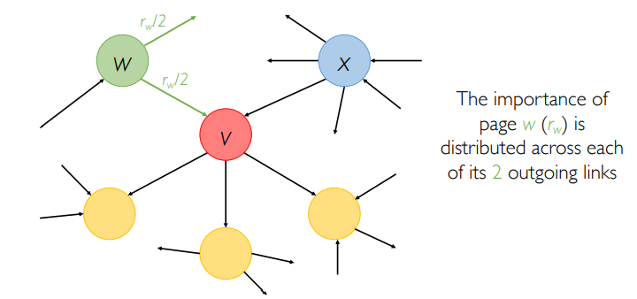
Pagerank

Slide 30
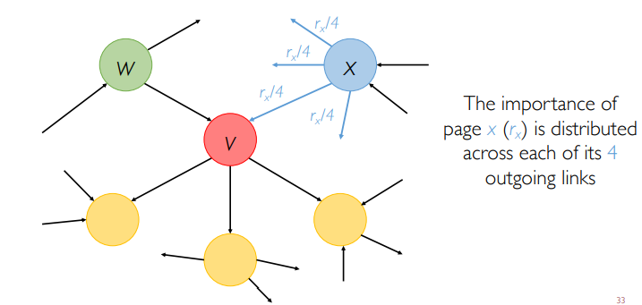
Pagerank

Slide 31
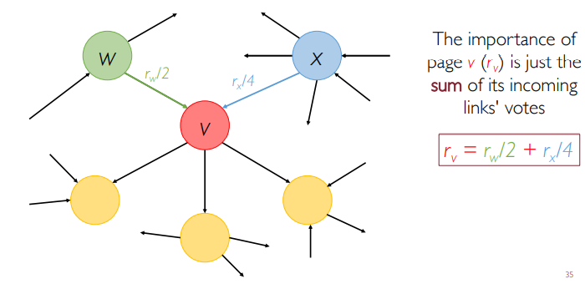
Pagerank

Slide 32
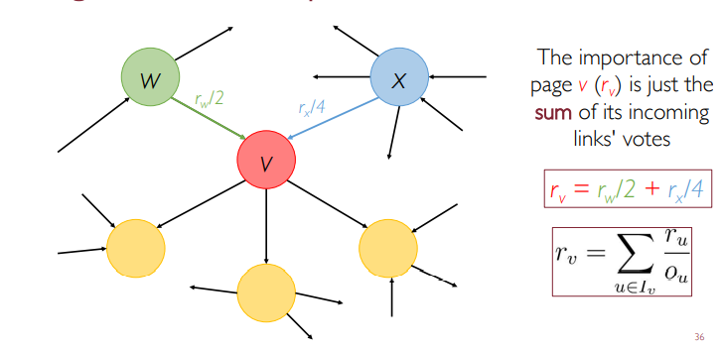
Pagerank

Slide 33
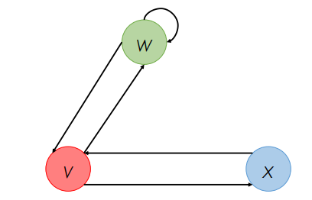
Pagerank
The “Flow” model

Slide 34
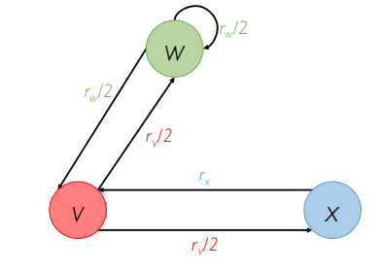
Pagerank
The “Flow” model

Slide 35
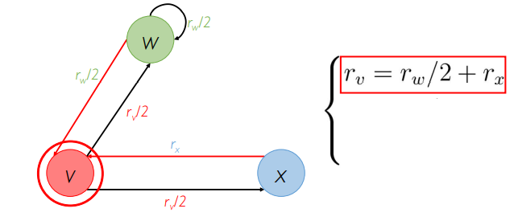
Pagerank
The “Flow” model

Slide 36
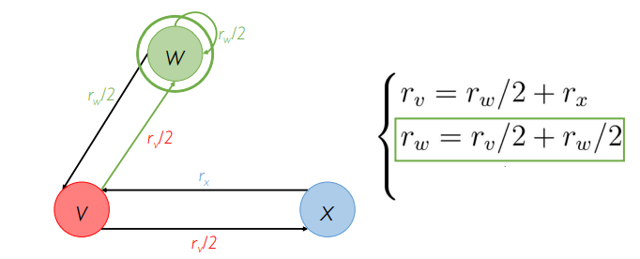
Pagerank
The “Flow” model

Slide 37
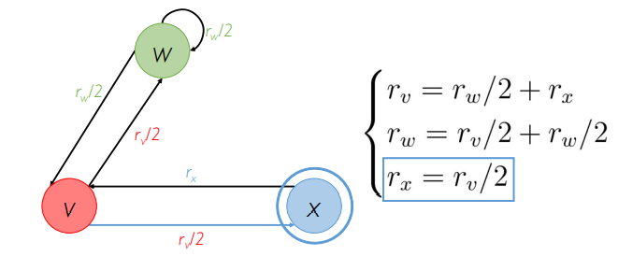
Pagerank
The “Flow” model
3 equations, 3 unknowns, r_{v}, r_{w}, and r_{x}
No unique solution

Slide 38
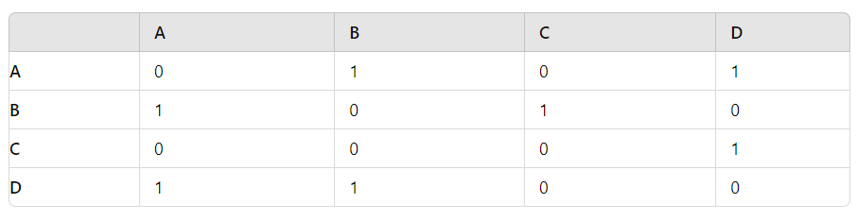
Pagerank
The “Flow” model

Slide 39
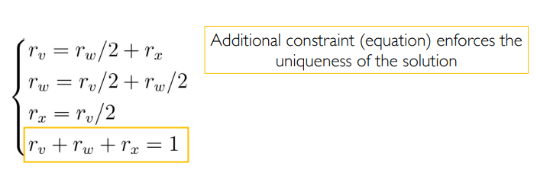
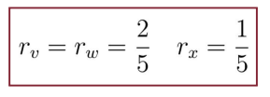
Pagerank
The “Flow” model
This may work for small examples (e.g., using Gaussian elimination), but we need a better method for large web-size graphs.
We need a new formulation!

Slide 40
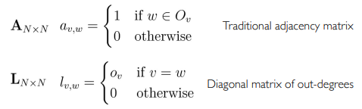


Pagerank
Matrix formulation
(If w → v)
[2] Big Data Computing, Gabriele Tolomei, Department of Computer Science Sapienza Università di Roma, 2020-2021

Slide 41
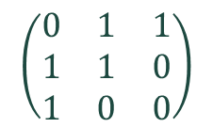

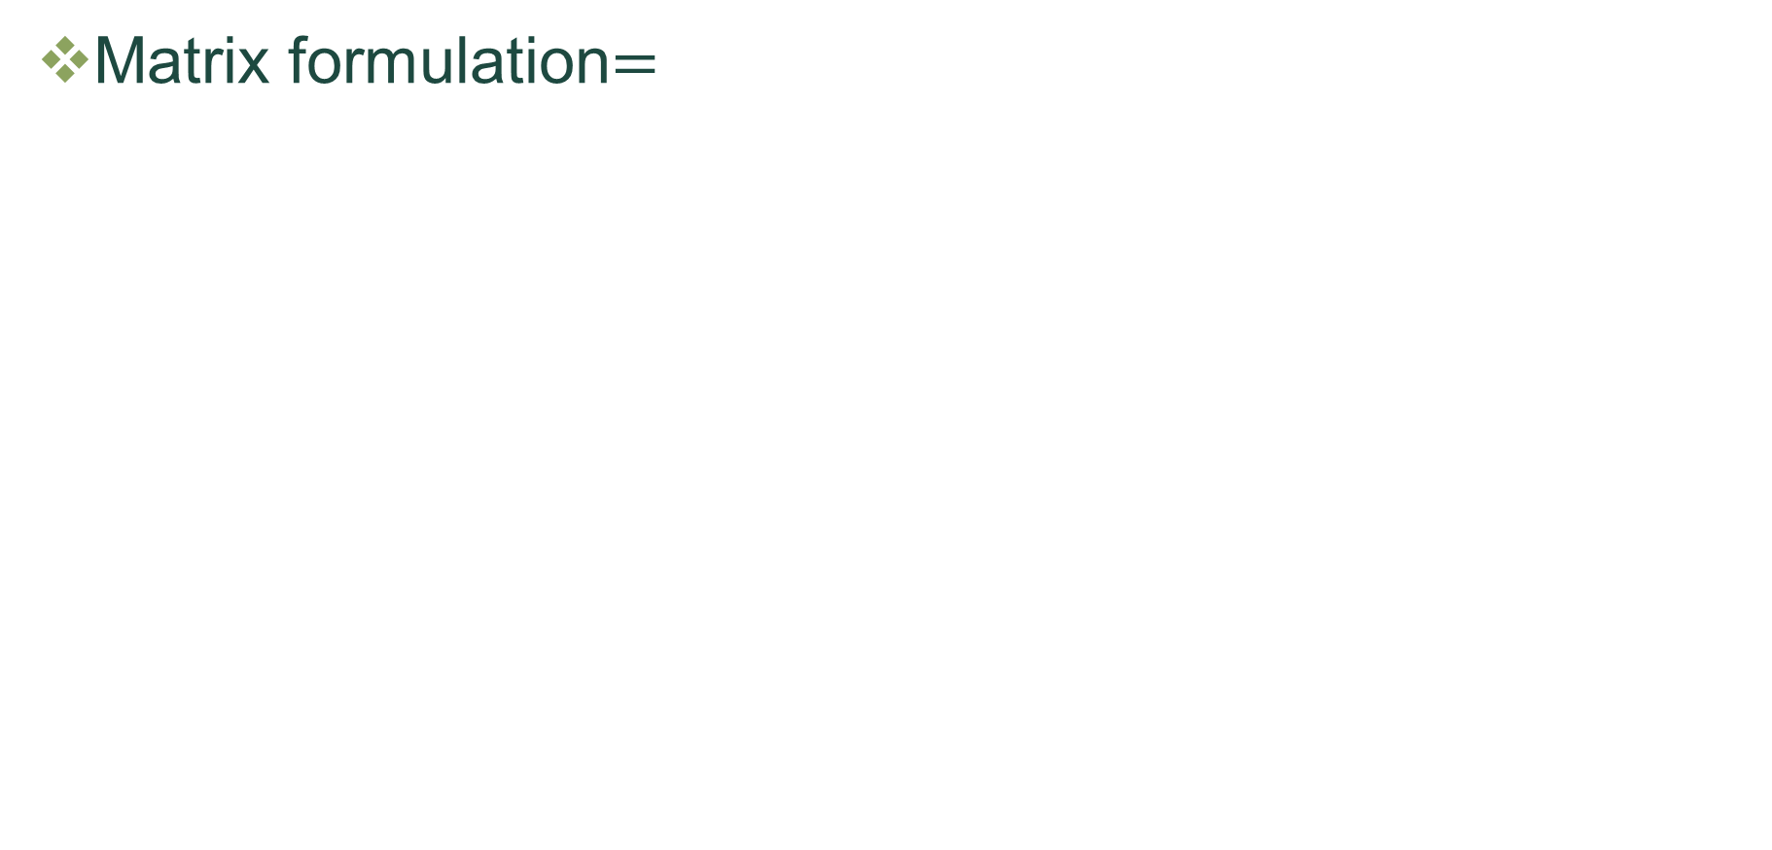
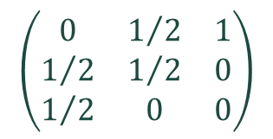
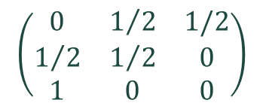
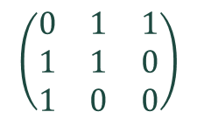
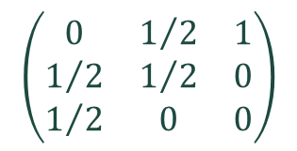
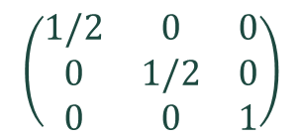
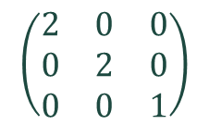
Pagerank
Matrix formulation$=$
$$\left(\begin{matrix}0 & 1 & 1 \\ 1 & 1 & 0 \\ 1 & 0 & 0\end{matrix}\right)$$
$$\left(\begin{matrix}2 & 0 & 0 \\ 0 & 2 & 0 \\ 0 & 0 & 1\end{matrix}\right)$$
(If w → v)
$$\left(\begin{matrix}0 & 1/2 & 1 \\ 1/2 & 1/2 & 0 \\ 1/2 & 0 & 0\end{matrix}\right)$$
$$\left(\begin{matrix}1/2 & 0 & 0 \\ 0 & 1/2 & 0 \\ 0 & 0 & 1\end{matrix}\right)$$
$$\left(\begin{matrix}0 & 1 & 1 \\ 1 & 1 & 0 \\ 1 & 0 & 0\end{matrix}\right)$$
$$\left(\begin{matrix}0 & 1/2 & 1/2 \\ 1/2 & 1/2 & 0 \\ 1 & 0 & 0\end{matrix}\right)$$
$$\left(\begin{matrix}0 & 1/2 & 1 \\ 1/2 & 1/2 & 0 \\ 1/2 & 0 & 0\end{matrix}\right)$$
$$=$$
→

Slide 42
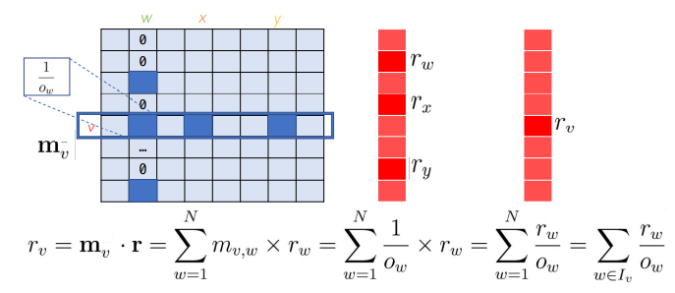
Pagerank
The “Flow” model

Slide 43


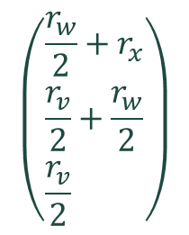

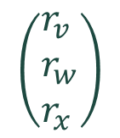
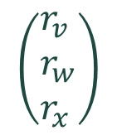
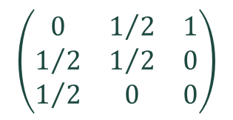

Pagerank
The “Flow” model
$$\left(\begin{aligned}&\frac{r_{w}}{2}+r_{x} \\ &\frac{r_{v}}{2}+\frac{r_{w}}{2} \\ &\frac{r_{v}}{2}\end{aligned}\right)$$
$$\left(\begin{matrix}0 & 1/2 & 1 \\ 1/2 & 1/2 & 0 \\ 1/2 & 0 & 0\end{matrix}\right)$$
$$\left(\begin{aligned}&r_{v} \\ &r_{w} \\ &r_{x}\end{aligned}\right)$$
$$\left(\begin{aligned}&r_{v} \\ &r_{w} \\ &r_{x}\end{aligned}\right)$$
$$=$$
$$=$$

Slide 44

Pagerank
Matrix formulation

Slide 45
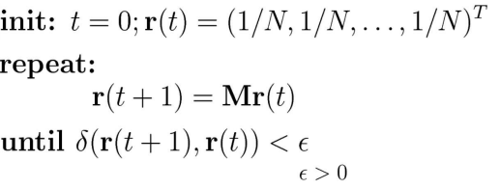
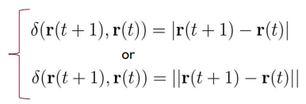
Pagerank
Power iteration method

Slide 46
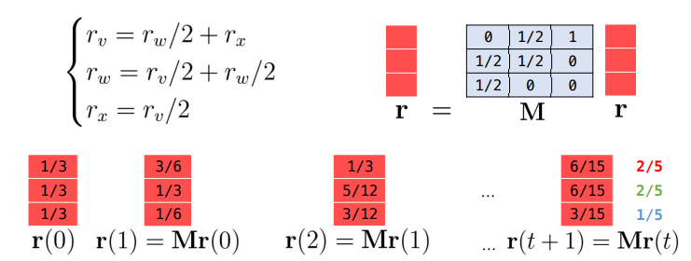

Pagerank
Power iteration method: Example

Slide 47
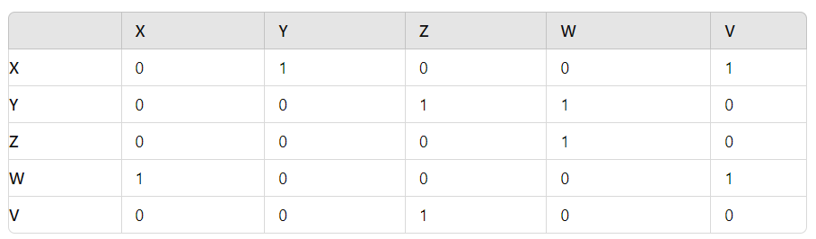
Pagerank
Exercise 1: Example of an adjacency matrix representing the links between 5 websites (X, Y, Z, W, V)

Slide 48
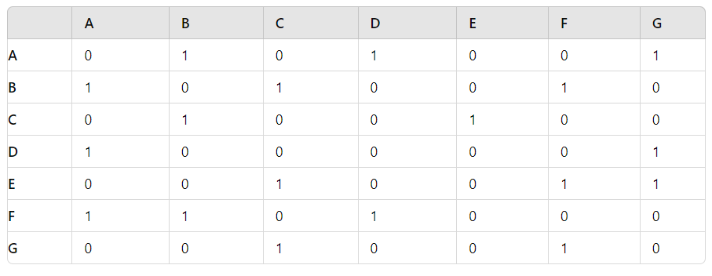
Pagerank
Exercise 2: Example of an adjacency matrix representing the links between 7 websites (A, B, C, D, E, F, G)

Slide 49
Pageranks
Pagerank: Problems
Dead ends (have no out-links)
Spider traps (all out-links are within the group)
[3] Mining of Massive Datasets, Jure Leskovec, Anand Rajaraman, Jeff Ullman Stanford University

Slide 50

Pageranks
Dead ends problem

Slide 51

Pageranks
Spider traps problem

Slide 52




Pagerank
[3] Mining of Massive Datasets, Jure Leskovec, Anand Rajaraman, Jeff Ullman Stanford University

Slide 53

Pagerank
β = 0.8

Slide 54
Pagerank
Exercise 3: The google Matrix

Slide 55

Pagerank
The pagerank Algrorithm
[3] Mining of Massive Datasets, Jure Leskovec, Anand Rajaraman, Jeff Ullman Stanford University

Slide 56
Pagerank
Example: pagerank Algrorithm

Slide 57
Pagerank
Example:
r(0)=[0.25,0.25,0.25,0.25]
Lần 1:
r(0)=[0.20,0.20,0.10,0.30]
S=0.20+0.20+0.10+0.30=0.80
r(1)=r(0)+(1-0.8)/4 = [0.25,0.25,0.15,0.35]
Lần 2:
r(1)=[0.24,0.24,0.10,0.22]
S=0.8
r(2)=r(1)+(1-0.8)/4 =[0.29,0.29,0.15,0.27]
Lần 3:
r(2)=[0.224,0.224,0.116,0.236]
S=0.8
r(3)=r(2)+(1-0.8)/4 =[0.274,0.274,0.166,0.286]

Slide 58
Pagerank
Exercise 4: The pagerank Algrorithm

Slide 59


HITS
HITS (Hypertext-Induced Topic Selection)
Ranking:
1. Authority:
Sum of hub scores of pages pointing to it
2. Hub:
Sum of authority scores of pages it points to

Slide 60
HITS
Algorithm HITS:
Step 1: Create the Initial Set
Input: A search query or a specific topic.
Create the Initial Set: Start by creating an initial set of web pages related to the query.
Step 2: Construct the Link Graph
Build the Link Graph: From the initial set, build a link graph
Step 3: Initialize Hub and Authority Scores

Slide 61

HITS
Step 4: Update Hub and Authority Scores

Slide 62
HITS
Step 5: Normalize the Scores
Step 6: Convergence
Repeat Step 4 and Step 5 until the scores converge
Step 7: Ranking and Results
Authorities: Pages with high Authority scores are considered authoritative on the topic.
Hubs: Pages with high Hub scores are those that effectively link to authoritative pages.

Slide 63

HITS
Example:
Authority?
Hub?

Slide 64
HITS
Exercise 5:

Slide 65
HITS # PageRank
PageRank:
It is a global, query-independent link analysis algorithm.
It is not used directly for ranking, stored as a static feature.
HITS:
It is a query-dependent link analysis algorithm.
It is applied after a user query is issued, operating on a subset of pages relevant to the query.

Slide 66
Content
Graph and Large graph
Web graph
Link analysis
  3.1. Introduce
  3.2. Page rank algorithm
  3.3. Page rank for massive data
  3.4. Hits algorithm
  3.5. Trust rank
  3.6. Web spam
Conlusion

Slide 67
Trust rank
What is Trust Rank?
Trust Rank is an algorithm used to evaluate the trustworthiness of websites
Purpose:
To differentiate between legitimate websites and spam or low-quality sites.
To improve the quality of search engine results by promoting reliable sources

Slide 68
Trust rank
How Does Trust Rank Work?
Seed Pages:
Starts with a set of highly trusted websites known as "seed pages" (e.g., government sites, educational institutions, reputable organizations).
Trust Propagation:
Trustworthiness is passed from seed pages to other sites through hyperlinks.
Websites linked by trusted sites inherit a higher Trust Rank.
The further a site is from the seed pages in the link structure, the lower its Trust Rank.

Slide 69
Trust rank
Example of Trust Rank Propagation
Step 1: Trusted Site A serves as a seed page with high Trust Rank.
Step 2: Website B links directly from Trusted Site A, receiving a high Trust Rank.
Step 3: Website C links from Website B, receiving a moderate Trust Rank.
Observation: Spam sites typically have limited or no links from trusted sources, resulting in low Trust Rank.

Slide 70
Search Engine
Pipeline
User Query
Retrieval (Content relevance)
  Retrieve N candidate web pages based on textual or semantic relevance
Global Ranking Signals: PageRank, Trust / Freshness
Topic-specific Analysis:
  HITS → Hub & Authority
Final Re-ranking: Produce the final ranking by combining
  Relevance + PageRank + HITS + other signals

